Slide 1
Depression Risk Indicators Via Active Music Listening For Before and During COVID-19 Pandemic
By
Dhruv Mahajan [2020201065]
Arpit Maheshwari [2020201078]
[Surana, A., Goyal, Y., Alluri, V. (2020) Static and Dynamic Measures of Active Music Listening as Indicators of Depression Risk. Proc. SMM20, Workshop on Speech, Music and Mind 2020, 1-5, DOI: 10.21437/SMM.2020-1]

Slide 2
Research Objective
We aim to unravel static and dynamic patterns existing in active listening behavior of individuals which may act as indicators of risk for depression pre and during COVID-19 pandemic, based on the paper “Static and Dynamic Measures of Active Music Listening as Indicators of Depression Risk”.

Slide 3
Hypothesis
Several research have demonstrated that during periods of depression, there is a strong reliance on listening to music impacting moods, emotions and altering affect states of an individual.
It is evident that using music for rumination, avoidance and mood worsening is an indicator of risk for depression. Although, due to the ongoing COVID-19 pandemic, these indicators may become more prominent.
Standard questionnaires having self-reported musical consumption data and measures, may suffer from demand characteristics and/or social desirability bias.
Hence, by using big data we aim to analyse these indicators being affected by COVID-19 .

Slide 4
Methodology
The methodology is divided into three parts : Dataset, Feature Extraction, Statistical Testing.
Dataset - Active music listening of users pre and during COVID-19 pandemic [from last.fm user data]. Users’ well-being is measured using standard diagnostic questionnaire, the Kessler’s Psychological Distress Scale (K10).
Feature Extraction - It majorly comprises of 3 parts Static, Session based and Dynamic feature extraction
Process for Static Feature Extraction
Using Spotify public API for extracting 10 acoustic features from a track.
8 Audio features - danceability, loudness, speechiness, acousticness, instrumentalness, liveness, tempo, and mode.
2 Emotion features - valence and energy/arousal, forming Valence-Arousal space representing four emotional states - happiness, anger, sadness, and tenderness.
Calculate a Quadrant Prevalence Score (QPS) which represents the proportion of tracks in the respective quadrants in each user’s listening history.

Slide 5
Methodology
Process for Session-based Feature Extraction:
A session is defined as a period of continuous listening activity, helps in obtaining time-varying values for audio and QPS features, for each user over his/her listening period.
Individuals at-risk for depression may engage in repetitive music listening behaviors, to quantify this, we determine a Repetitiveness Index per user.
Process for Dynamic Feature Extraction :
Dynamic behavior helps us to better understand users’ mood shifts characterized by variability and inertia.
Higher inertia and extreme variability are representative of ill-being and depressive moods.

Slide 6
Methodology
Statistical Testing :
First, divide users using K-10 scores, K-10 < 20 fall under the No-Risk group while K10 > 29 will form At-Risk group.
Perform Wilcoxon signed-rank test on the static features for At Risk users for before and during COVID-19
Then test a Type 1 error (false positive), to ensure that the observed differences are not due to chance.
Next we will perform Spearman correlations between K10 and all users’ number of sessions, total play count, and RI.
Similarly, we will find correlation between K10 and static and dynamic measures of audio and emotion features.
The observations should reveal that individuals with greater depression risk often possess higher dependency on sad music with greater repetitiveness in their listening habits. Furthermore, we compare the results for pre and during COVID-19.

Slide 7
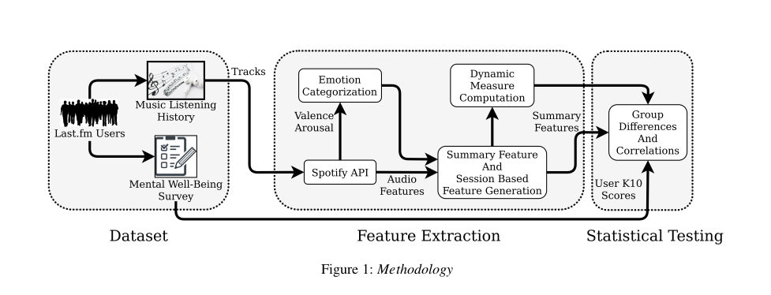
Methodology Overview
Ref: Static and Dynamic Measures of Active Music Listening as Indicators of Depression Risk

Slide 8
Steps and Intermediate Results
Number of No-Risk(K10<20) users are 180 and At-Risk users are 120 (K10>29) from 485 users.
Acoustic features for 9,00,000+ songs extracted from Spotify API. For example: ('Oscillate Wildly - 2011 Remaster', 'The Smiths') [0.657, 0.791, 9, -5.996, 0, 0.0278, 0.0205, 0.298, 0.101, 0.783, 116.329]
Then summarized the features based on sessions including QPS score for each quadrant for both before and After COVID-19 data. For example shown in image below.
After this also summarized features and calculated repetitiveness index for each user. across all sessions.

Slide 9
Steps and Intermediate Results
Then we extracted Dynamic Features i.e. variability and inertia for all static features.
After extracting these features we performed Wilcoxon signed-rank test for comparing At Risk users for Before and During COVID-19. Also performed bootstrapping to take in account for Type I error.
danceability | loudness | mode | speechiness | acousticness | instrumentalness | liveness | tempo | QPS_Q1 | QPS_Q2 | QPS_Q3 | QPS_Q4
0.2621 | 0.7085 | 0.8756 | 0.8411 | 0.9309 | 0.9268 | 0.9145 | 0.9969 | 0.2966 | 0.1676 | 0.9309 | 0.8899

Slide 10
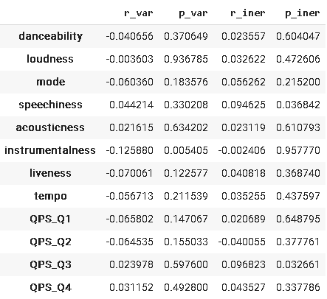
Results
Then we have performed spearman correlation with K-10 for dynamic features.
We have observed positive correlations for K10 and number of sessions (r = 0.189, p = 0.0002), total playcount (r = 0.134, p = 0.002) and RI (r = 0.124, p = 0.005) for before COVID-19.
We have observed positive correlations for K10 and number of sessions (r = 0.185, p = 0.0003), total playcount (r = 0.104, p = 0.024) and RI (r = 0.140, p = 0.001) for during COVID-19.
Also, K10 had a negative correlation with variability in instrumentalness (r = −0.12, p = 0.005). Also, K10 correlated positively with inertia in speechiness(r = 0.09, p = 0.03).

Slide 11
Further Analysis
Wilcoxon signed-rank test(All) - We observed the following after our experiments:-
Inertia of QPS_Q1 → p_value = 0.040
Static QPS_Q4 → p_value = 0.023
Variability QPS_Q4 → p_value = 0.005
Wilcoxon signed-rank test(At Risk) - We observed the following after our experiments:-
Inertia of QPS_Q3 → p_value = 0.010
Inertia of QPS_Q4 → p_value = 0.010
Wilcoxon signed-rank test(No Risk) - We did not observe any significant inference after our experiments.

Slide 12
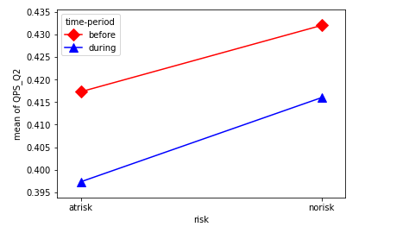
Further Analysis
Two way Anova
Time-period (before-covid / during-covid) and risk (At-risk/No-risk) as the 2 independent variables and consider each feature as a dependent variable one at a time.
Static QPS_Q1, corresponding to source as time-period → p-value = 0.05. As p-value is on borderline, we are not considering it for any inference.
Static QPS_Q2, corresponding to source as time-period → p-value = 0.000015. Anger quality of music for both the groups, has decreased during COVID-19..

Slide 13
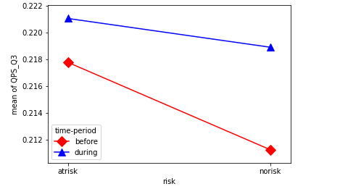
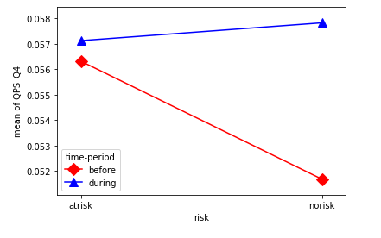
Further Analysis
Two way Anova
Static QPS_Q3, we didn’t find any significant difference. But on plotting Interaction Plot, we found increase in sad songs for both the groups during COVID-19 pandemic.
Static QPS_Q4, corresponding to source as time-period → p-value = 0.023. It is observed, there is a significant increase in tenderness quality of music during COVID-19 for ‘No Risk’ group.

Slide 14
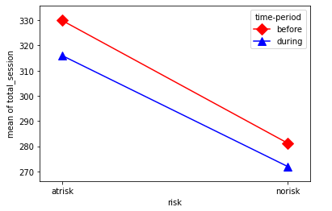
Further Analysis
Two way Anova
For Repetitiveness Index and Total Tracks, , we didn’t find any significant difference.
Total Session, corresponding to source as risk → p-value = 0.00018.
Pre COVID-19
Average Number of sessions per user : 302 Average Number of total tracks per user : 6928
During COVID-19
Average Number of sessions per user : 290 Average Number of total tracks per user : 7130

Slide 15
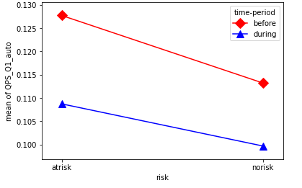
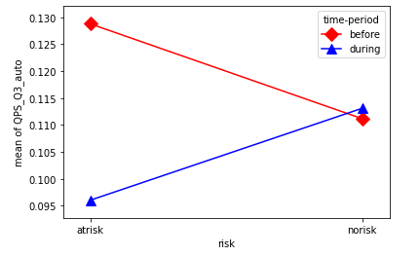
Further Analysis
Two way Anova
Inertia of QPS_Q1, corresponding to source as time-period → p-value = 0.035. Across sessions there is decrease in QPS_Q1 for both groups.
Inertia of QPS_Q3, corresponding to source as interaction → p-value 0.032. There is a significant drop in inertia of QPS_Q3 for at risk users.
Inertia of QPS_Q2, QPS_Q4 , no significant change observed.

Slide 16
Thank You

